Slide 1


Hospital Management System
Farzia Chowdhury
Fuadul Islam
Seragis Salekin

Slide 2
Introduction
The Hospital Isosceles designed for a Hospital to replace their existing manual, paper based system. This System targets to provide complete solution for Hospital and Health care services.
This System can be used in any Hospital, Clinic, Diagnostics or Pathology labs for maintaining patient details and appointment.
It Integrates the entire Resources of a Hospital into One Integrated Software Application.

Slide 3
Hospital Management Systems
This software targets to provide complete solution for Hospital and related services.
The software Includes following:
Admin
Patient login & Sign Up
Doctor login
Create/Edit User
Add/ Edit Doctor

Slide 4

Patient Appointment:
Configure an Appointment :
Here we can create the availability timings of a doctor Doctor wise appointment scheduling.
Daily,Weekly & Monthly Appointment scheduler.

Slide 5

APPOINTMENT MODULE
Configure an App ointment
Book Appointment
APPOINTMENT
View Appointment
Doctor and Admin
Appointment History

Slide 6
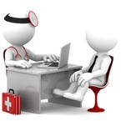
DOCTORS:
Doctor Profile
DOCTORS
View Appoint Patient
Update Profile

Slide 7
Admin Operation:
Patient
P.Information
D. Information
Appointment
Admin
Update Profile
Update Profile
Show Appointment
Select Doctor
Doctor History
History
Patient History
Doctor

Slide 8

User/Patient:
Patient Sign Up
PATIENT
Patient Login
Add Appointment

Slide 9
Patient/User:
Patient Registration:
Here patient has to register with all required information .
Here Patient can View doctor and Appoint to Doctor.
Here Patient also can view appoint history.

Slide 10
Isosceles Diagram
Patient
Registration to
Treatment
All Access to
Process
User
Isosceles
Has
Add
Doctor

Slide 11
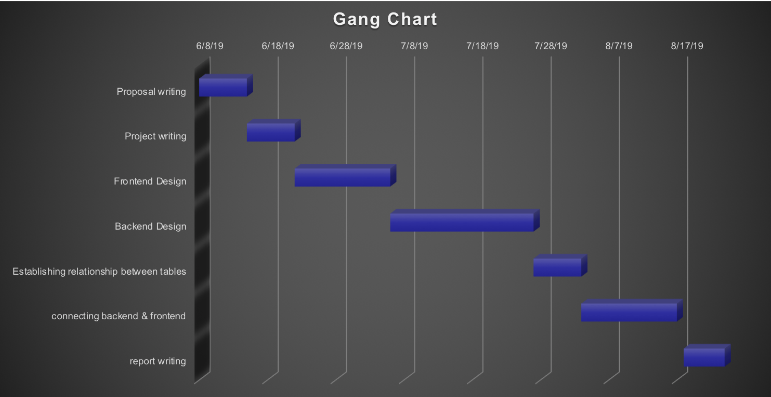
Gang Chart

Slide 12
Time Frame
Work | Time
Proposal writing | 1 week
Frontend Design | 2 Week
Backend Design | 3 Week
Establishing relationship between tables | 1 Week
connecting backend & frontend | 3 Week
Report Writing | 1 Week

Slide 13
Software & Programming language Used
PHP
jQuery
JavaScript
CSS
HTML
Xampp Server
Bracket

Slide 14
Result Analysis
Admin can control whole Isosceles hospital system. The admin can view the user & doctor login .
Admin can add doctor & doctor specialization & also control the patient appointment.
Admin delete any doctor & patient from the system.

Slide 15
Advantages
No harassment the patient to appoint the doctors.
The doctor can easily see the history of patient appointment
Admin can easily add & mange the doctor & also manage the patient.

Slide 16
Disadvantages
There is no added payment method to the doctor
The information of patient health report is not show to the doctor
No verification system added to confirm the patient appointment

Slide 17
Future Scope
A mobile application to make things easy and bring patient toward doctors.
Smart phones have become a part of our lives. They provide us thousands of assistive features and we have gladly become depended on this device. Smart phones are powered by many applications. Which are generally downloaded by users and some default applications preloaded by the company of that smartphone. An application that helps people to carry and check their complete medical record will give people more power. They will be able to check everything on the go while their ability to change or modify any data to make things up to date will always be there.

Slide 18
Conclusion
The project Isosceles is for computerizing the working in a hospital. The software takes care of all the requirements of an average hospital and is capable to provide easy and effective storage of information related to patients that come up to the hospital

Slide 19


